Slide 1
Recommender Systems -Konstantinos Stefanidis
By,
Brindhapriya Babu
Chethan Kashyap BM

Slide 2
OBJECTIVE:
The main objective of this assignment is to consider disagreements into account while producing the group recommendations for users.
We will be using Kendal tau distance to calculate the disagreements between users in group.
IMPLEMENTATION: (PART A)
Find the similar users using Pearson Correlation
Get the movie recommendations for 3 similar users using prediction function
Get the common movies between 3 users in the group
Calculate the movie recommendations for the group using Average Aggregation method and Least Misery Method.
Calculate Kendall tau correlation between user A against Avg aggregation and Least Misery approach.(Do the same for user B and C).

Slide 3
Kendall’s tau
tau = (P - Q) / sqrt((P + Q + T) * (P + Q + U))
Where,
P is the number of concordant pairs,
Q the number of discordant pairs,
T the number of ties only in x, and
U the number of ties only in y.
If a tie occurs for the same pair in both x and y, it is not added to either T or U.

Slide 4
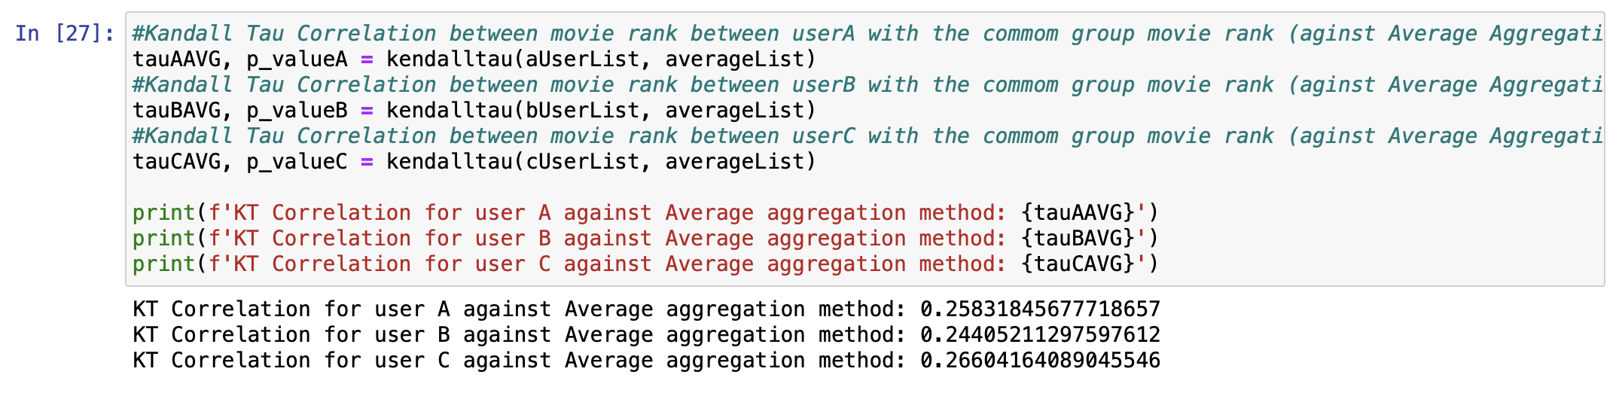
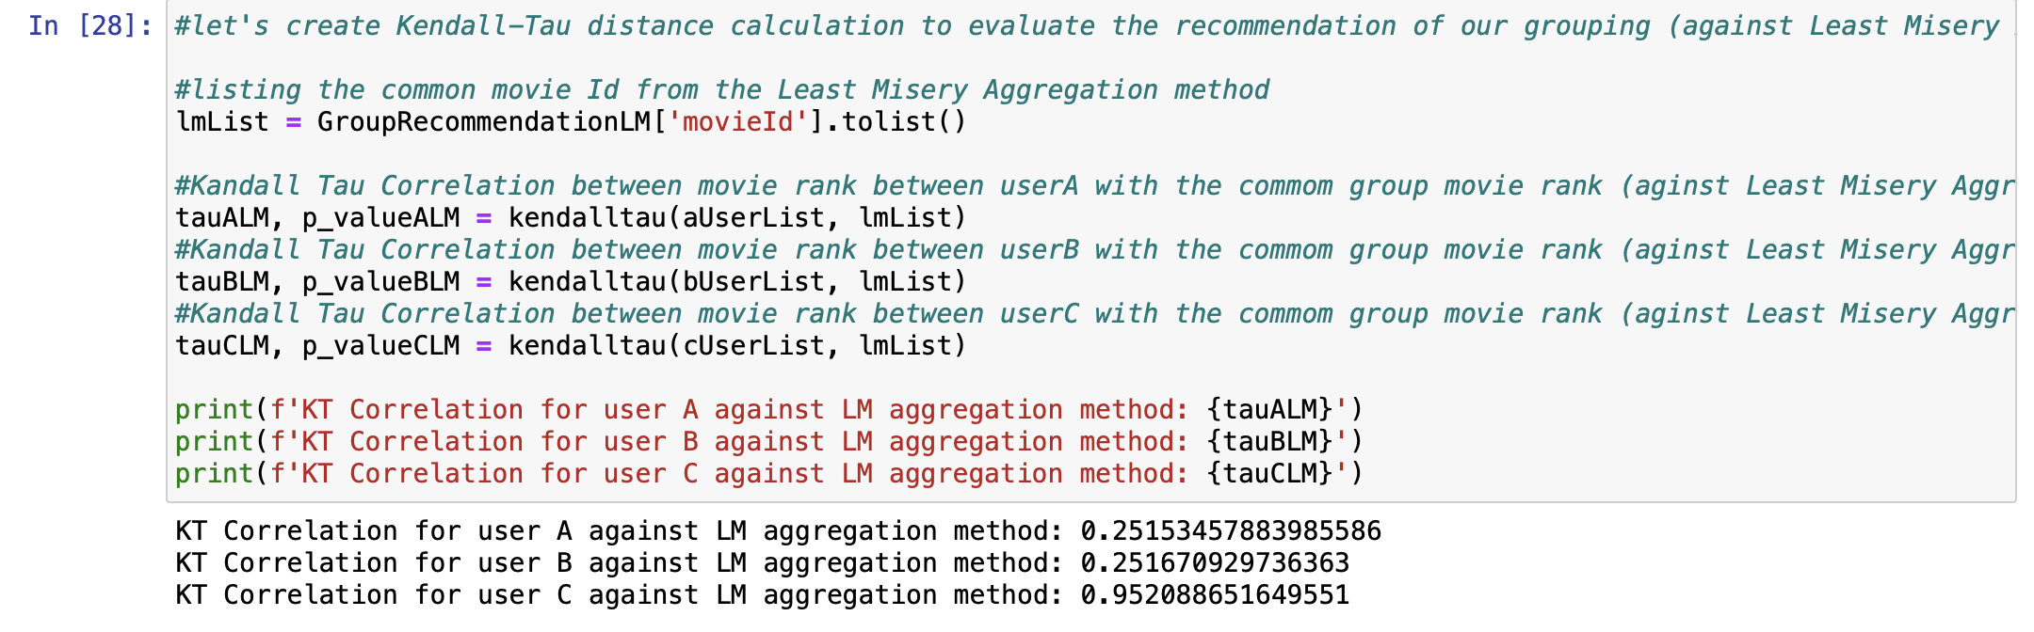

Slide 5
IMPLEMENTATION: (PART B)
Get a subgroup of users that are similar to a particular user.
Get the movie recommendations for the particular selected user and all the users present in the subgroup using Pearson correlation.
Then use Kendal tau correlation to find disagreements between the selected user and all the users present in the group.
Then select the similar users based on highest Kendall tau value.
Now, get the movie recommendations for the other two selected users using Pearson correlation and prediction function as in step two.
Get the common movies between 3 users in the group.
Calculate the movie recommendations for the group using Average Aggregation method and Least Misery Method.
Calculate Kendall tau correlation between user A against Avg aggregation and Least Misery approach.(Do the same for user B and C).
Verify the values of Kendal tau for users in part B against part A.

Slide 6
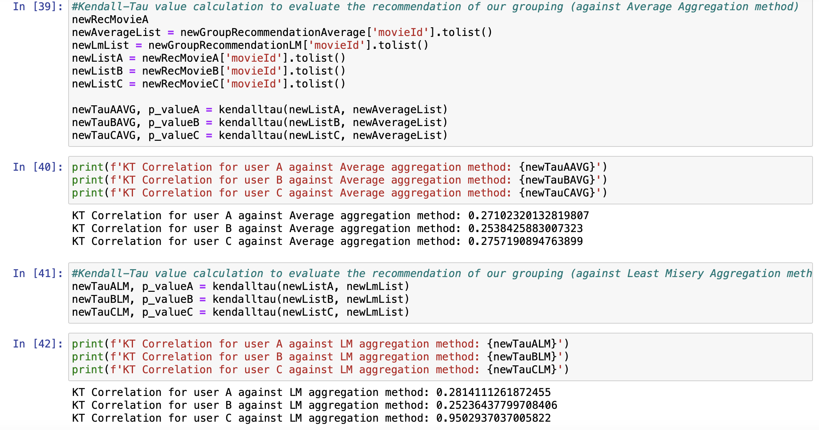

Slide 7
THANK YOU

